Slide 1
Chapter 3 Communication Concepts
3.1 General Considerations
3.2 Analog Modulation
3.3 Digital Modulation
3.4 Spectral Regrowth
3.5 Mobile RF Communications
3.6 Multiple Access Techniques
3.7 Wireless Standards
3.8 Appendix I: Differential Phase Shift
Keying
Behzad Razavi, RF Microelectronics.
Prepared by Bo Wen, UCLA

Slide 2
Chapter Outline
Modulation
Mobile Systems
AM,PM,FM
Intersymbol Interference
Signal Constellations
ASK,PSK,FSK
QPSK,GMSK,QAM
OFDM
Spectral Regrowth
Cellular System
Handoff
Multipath Fading
Diversity
Multiple Access
Techniques
Wireless
Standards
Duplexing
FDMA
TDMA
CDMA
GSM
IS-95 CDMA
Wideband CDMA
Bluetooth
IEEE802.11 a/b/g

Slide 3


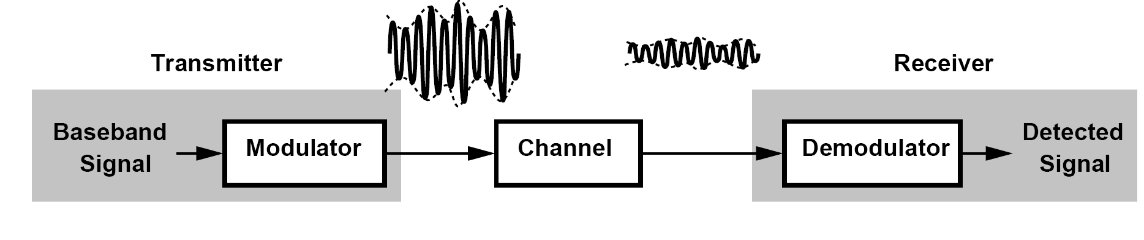
Journey of the Signal
Modulation varies certain parameters of a sinusoidal carrier according to the baseband signal.
A simple communication system consists of a modulator/transmitter, a channel, and a receiver/demodulator

Slide 4
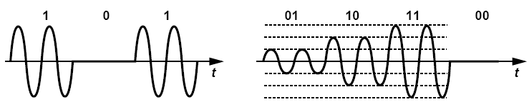
Important Aspects of Modulation
2-level
4-level
Detectability: the quality of the demodulated signal for a given amount of channel attenuation and receiver noise
Bandwidth Efficiency: the bandwidth occupied by the modulated carrier for a given information rate in the baseband signal
Power Efficiency: the type of power amplifier (PA) that can be used in the transmitter

Slide 5
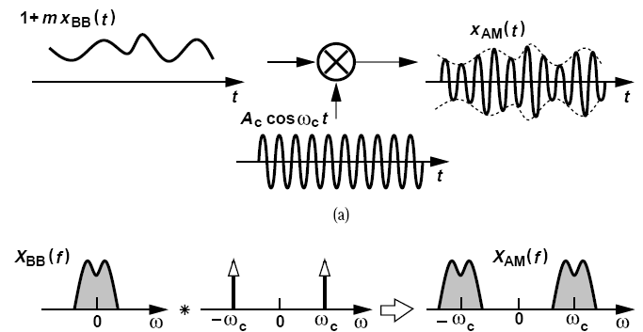

Analog Modulation: Amplitude Modulation
m is called the “modulation index”

Slide 6
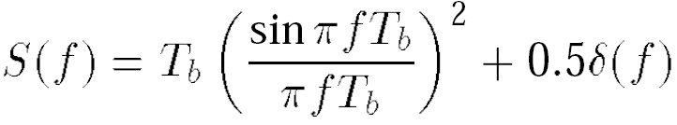
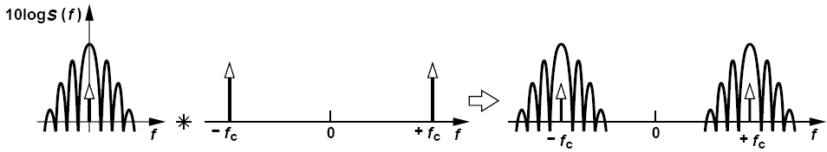
Example of Amplitude Modulation
The modulated signal shown in previous two level modulation schemes can be considered as the product of a random binary sequence toggling between zero and 1 and a sinusoidal carrier. Determine the spectrum of the signal.
Solution:
The spectrum of a random binary sequence with equal probabilities of ONEs and ZEROs is given by
Multiplication by a sinusoid in the time domain shifts this spectrum to a center frequency of ± f_{c}

Slide 7
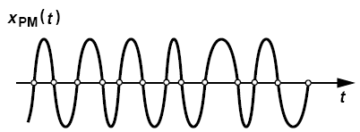

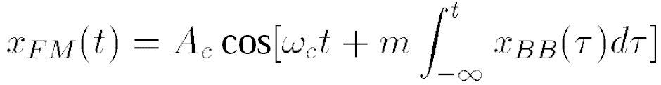
Analog Modulation: Phase & Frequency
Modulation
Phase Modulation: Amplitude is constant and the excess phase is linearly proportional to the baseband signal
Frequency Modulation: the excess frequency is linearly proportional to the baseband signal

Slide 8

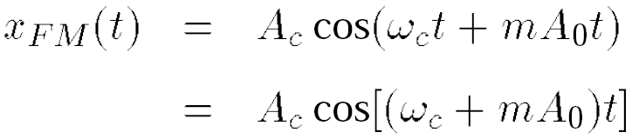
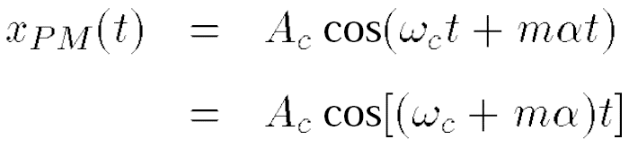
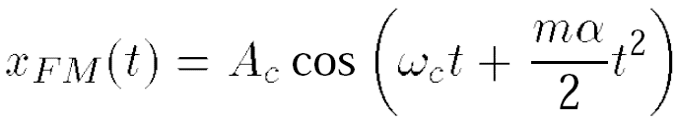
Example of Phase & Frequency
Modulation
Determine the PM and FM signals in response to (a) x_{BB}(t) = A₀, (b) x_{BB}(t) = αt.
Solution:
(a) For a constant baseband signal
PM output simply contains a constant phase shift
FM output exhibits a constant frequency shift equal to mA₀
(b) If x_{BB}(t) = αt
PM output experiences a constant frequency shift
This signal can be viewed as a waveform whose phase grows quadratically with time

Slide 9
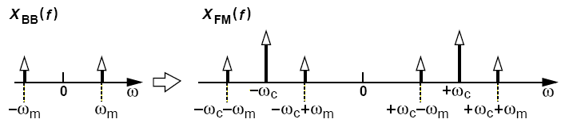
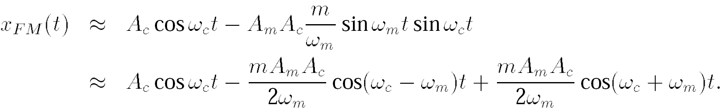
Narrowband FM Approximation
If mA_{m}/ω_{m} << 1rad

Slide 10
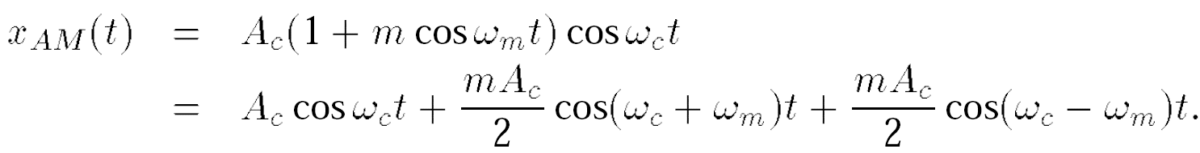
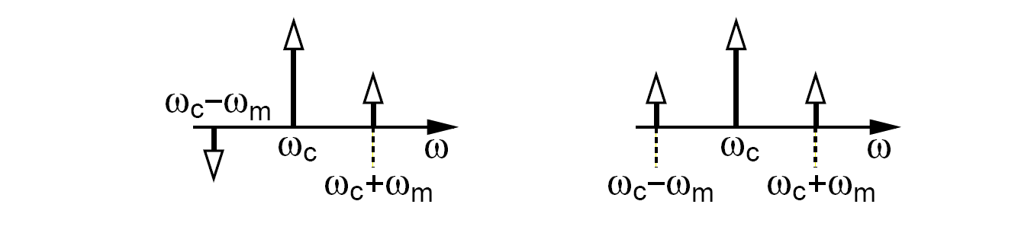
Example of AM, PM and FM Modulation(Ⅰ)
It is sometimes said that the FM(or PM) sidebands have opposite signs whereas AM sidebands have identical signs. Is this generally true?
Solution:
Equation above indeed suggests that cos(ω_{c} - ω_{m})t and cos(ω_{c} + ω_{m})t have opposite signs. Figure below (left) illustrates this case by allowing signs in the magnitude plot. For a carrier whose amplitude is modulated by a sinusoid, we have
Thus, it appears that the sidebands have identical signs. However, in general, the polarity of the sidebands per se does not distinguish AM from FM. Writing the four possible combinations of sine and cosine, the reader can arrive at the spectra shown below. Given the exact waveforms for the carrier and the sidebands, one can decide from these spectra whether the modulation is AM or narrowband FM.

Slide 11
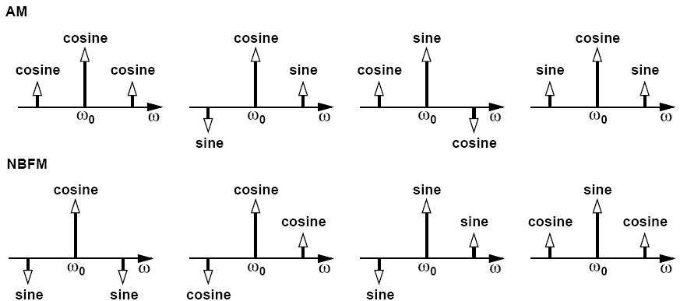
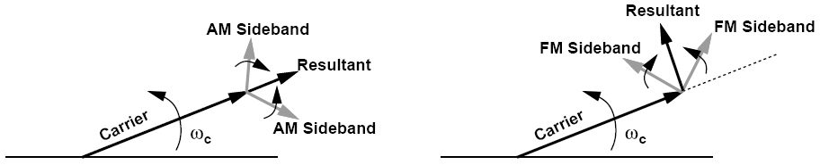
Example of AM, PM and FM Modulation(Ⅱ)
It is sometimes said that the FM(or PM) sidebands have opposite signs whereas AM sidebands have identical signs. Is this generally true?
Phasor
Interpretation
Of AM & FM

Slide 12
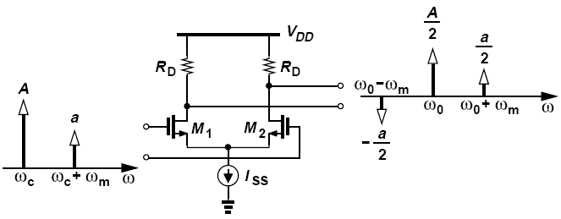
Another Example of Modulation (Ⅰ)
The sum of a large sinusoid at ω_{c} and a small sinusoid at ω_{c} + ω_{m} is applied to a differential pair. Explain why the output spectrum contains a component at ω_{c} - ω_{m}. Assume that the differential pair experiences “hard limiting,” i.e., A is large enough to steer I_{SS} to each side.
Solution:
Let us decompose the input spectrum into two symmetric spectra as shown in figure above (left). The one with sidebands of identical signs can be viewed as an AM waveform, which, due to hard limiting, is suppressed at the output. The spectrum with sidebands of opposite signs can be considered an FM waveform, which emerges at the output intact because hard limiting does not affect the zero crossings of the waveform.

Slide 13
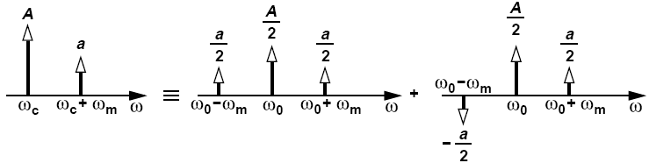
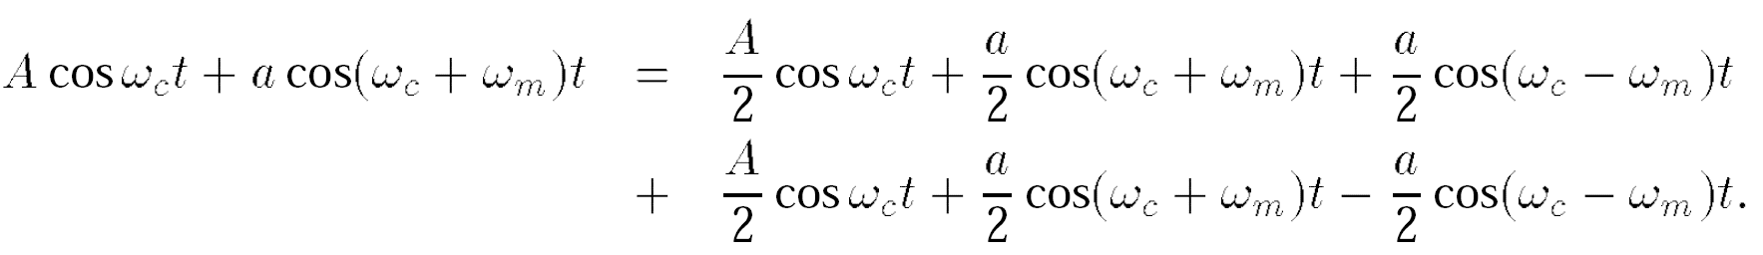
Another Example of Modulation (Ⅱ)
The sum of a large sinusoid at ω_{c} and a small sinusoid at ω_{c} + ω_{m} is applied to a differential pair. Explain why the output spectrum contains a component at ω_{c} - ω_{m}. Assume that the differential pair experiences “hard limiting,” i.e., A is large enough to steer I_{SS} to each side.
Solution:

Slide 14
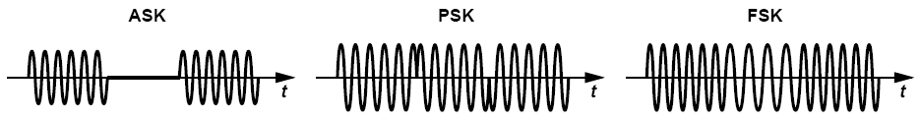
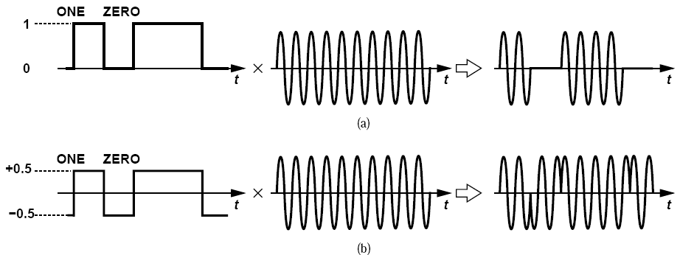
Digital Modulation: ASK,PSK,FSK
If data = ZERO
If data = ONE
ASK
PSK
Called “Amplitude Shift Keying”, “Phase Shift Keying”, and “Frequency Shift Keying”

Slide 15
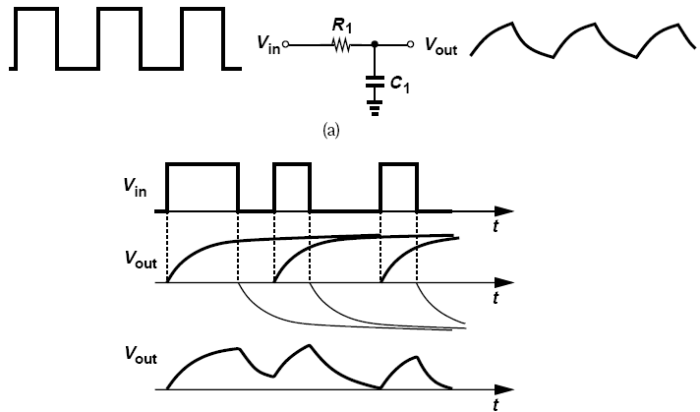
Digital Modulation: Intersymbol
Interference
A signal cannot be both time-limited and bandwidth-limited.
Each bit level is corrupted by decaying tails created by previous bits.

Slide 16
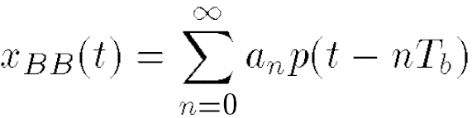
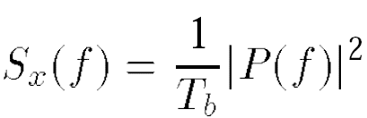
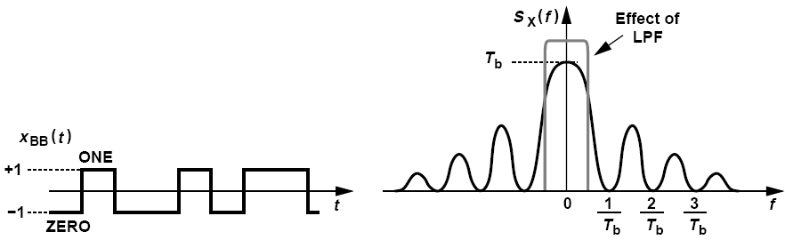
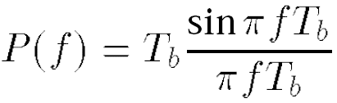
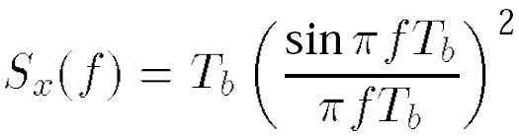
Example of Intersymbol
Interference
Determine the spectrum of the random binary sequence, x_{BB}(t), in figure below and explain, in the frequency domain, the effect of low-pass filtering it.
Solution:
We can express the sequence as
The spectrum is given by:
For a rectangular pulse of width T_{b}

Slide 17
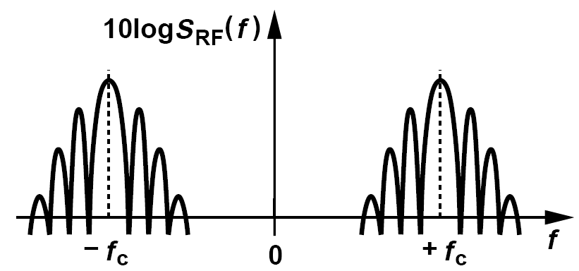

The Spectrum of PSK and ASK Signal
The upconversion operation shifts the spectrum to ±f_{c}
Spectrum of ASK is similar but with impulses at ±f_{c}

Slide 18
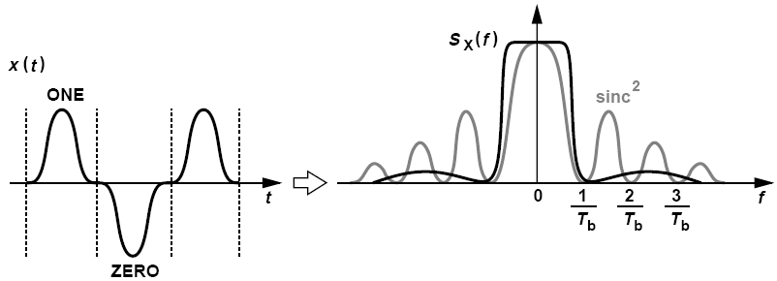
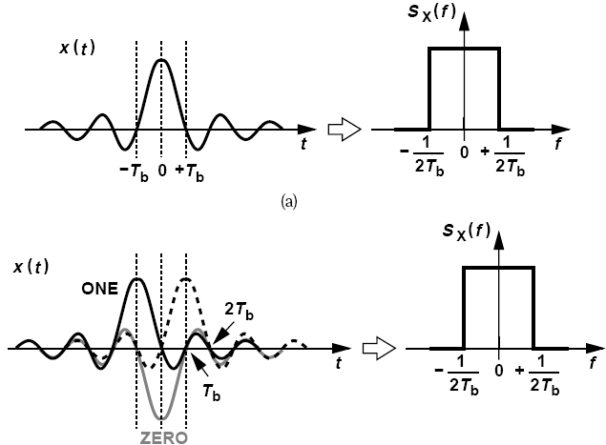
Pulse Shaping
Baseband pulse is designed to occupy a small bandwidth.
Random binary sequence spectrum still remains a rectangle.

Slide 19
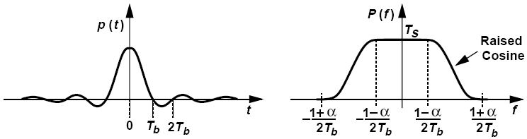
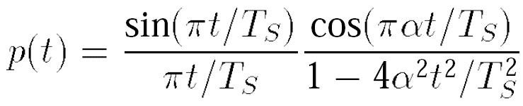
Raised-cosine Pulse Shaping
α: roll-off factor, typical values are in the range of 0.3~0.5

Slide 20
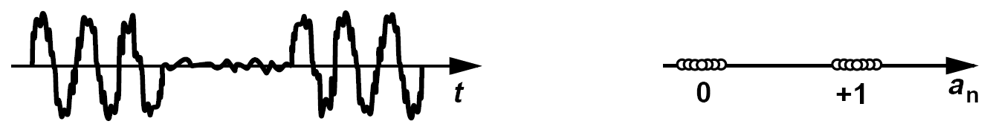
Signal Constellation: Binary PSK and ASK
Ideal
Noisy
Plot the constellation of an ASK signal in the presence of amplitude noise.
Solution:
Noise corrupts the amplitude for both ZEROs and ONEs.

Slide 21
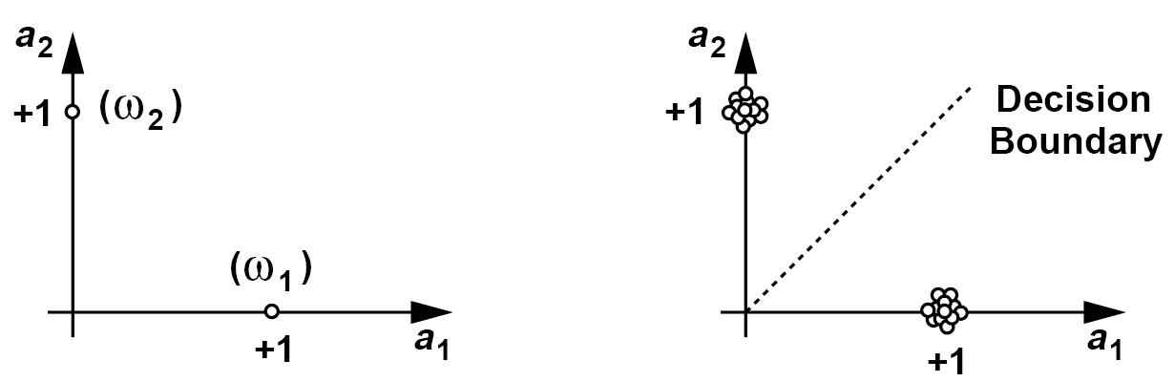
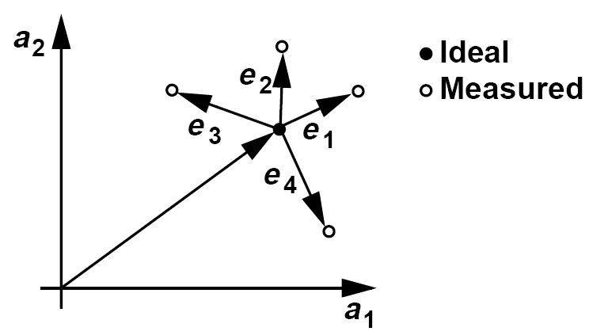
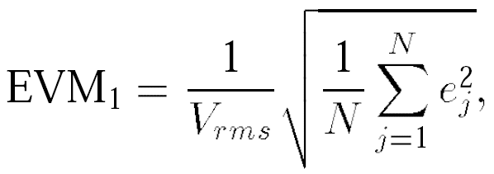
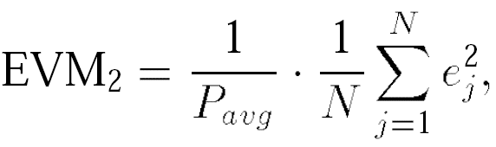
Signal Constellation: FSK and EVM
For FSK:
Ideal
Noisy
The constellation can also provide a quantitative measure of the impairments that corrupt the signal. Representing the deviation of the constellation points from their ideal positions, the “error vector magnitude” (EVM) is such a measure.

Slide 22
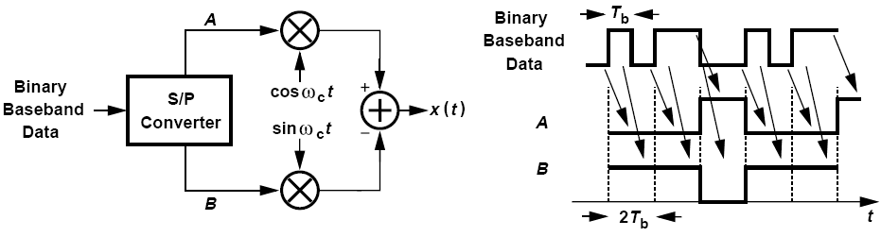
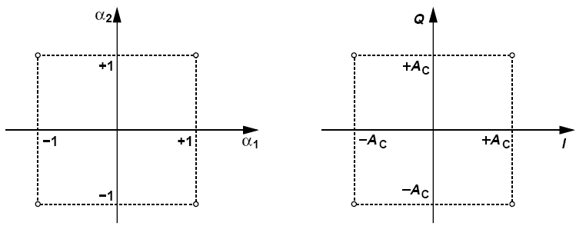
Quadrature Modulation
QPSK halves the occupied bandwidth
Pulses appear at A and B are called symbols rather than bits
I for in-phase and Q for Quadrature

Slide 23
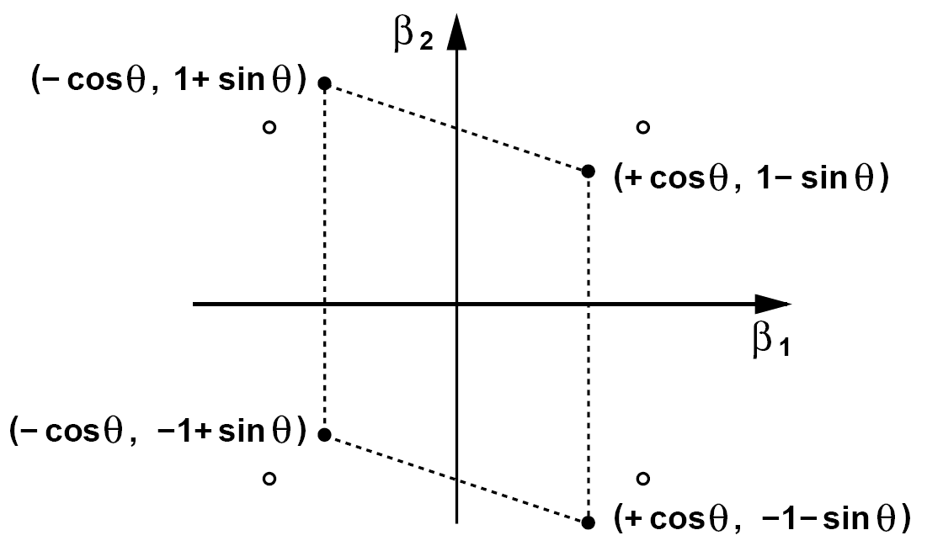
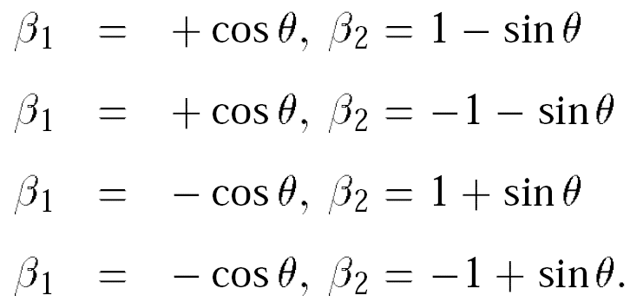
Example of Signal Constellation
Due to circuit nonidealities, one of the carrier phases in a QPSK modulator suffers from a small phase error (“mismatch”) of θ
Construct the signal constellation at the output of this modulator
Solution:

Slide 24
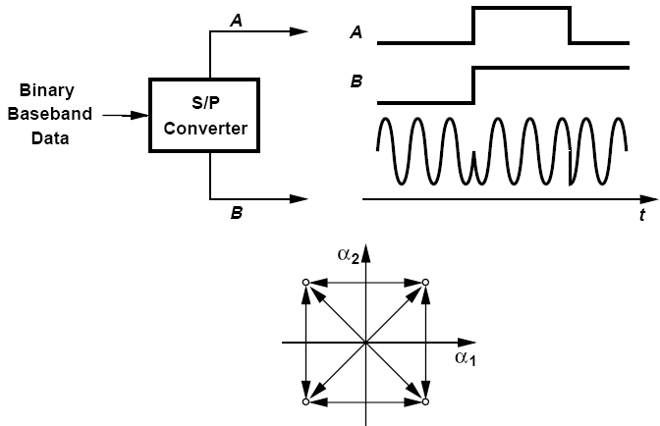
Important Drawback of QPSK (Ⅰ)
Important drawback of QPSK stems from the large phase changes at the end of each symbol.

Slide 25
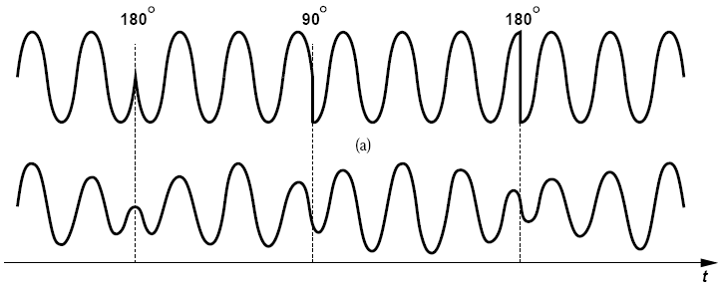
Important Drawback of QPSK (Ⅱ)
With pulse shaping, the output signal amplitude (“envelope”) experiences large changes each time the phase makes a 90 or 180 degree transition.
Resulting waveform is called a “variable-envelope signal”. Need linear PA

Slide 26
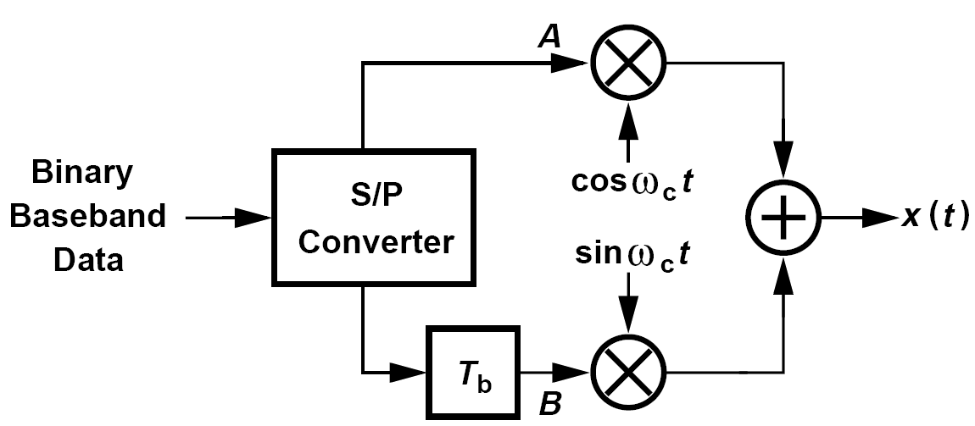
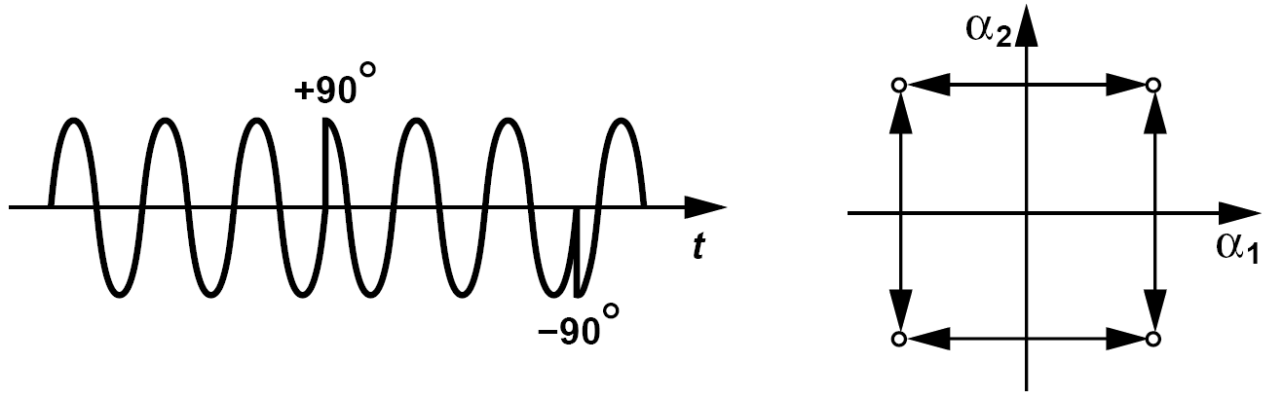
OQPSK
OQPSK does not lend itself to differential encoding

Slide 27
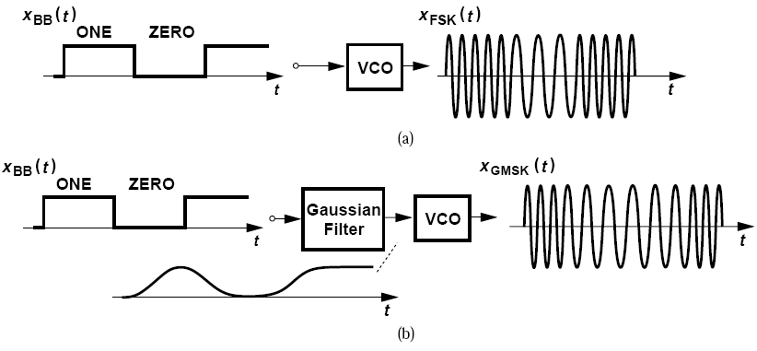
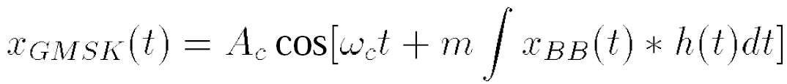
GMSK and GFSK Modulation
Gaussian minimum shift keying (GMSK), modulation index m = 0.5
Gaussian frequency shift keying (GFSK), modulation index m = 0.3

Slide 28
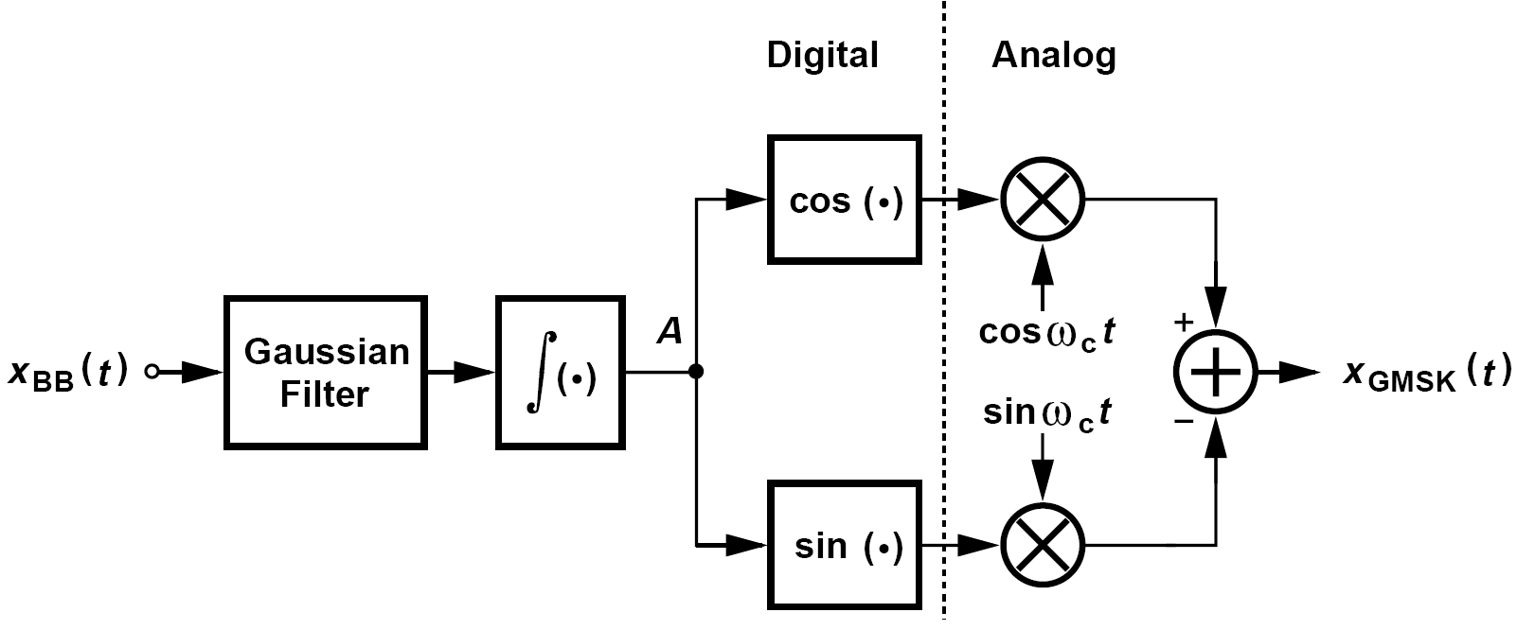
Example of GMSK Modulator Construction
Construct a GMSK modulator using a quadrature upconverter.
Solution:
We can therefore construct the modulator as shown above, where a Gaussian filter is followed by an integrator and two arms that compute the sine and cosine of the signal at node A. The complexity of these operations is much more easily afforded in the digital domain than in the analog domain (Chapter 4).

Slide 29
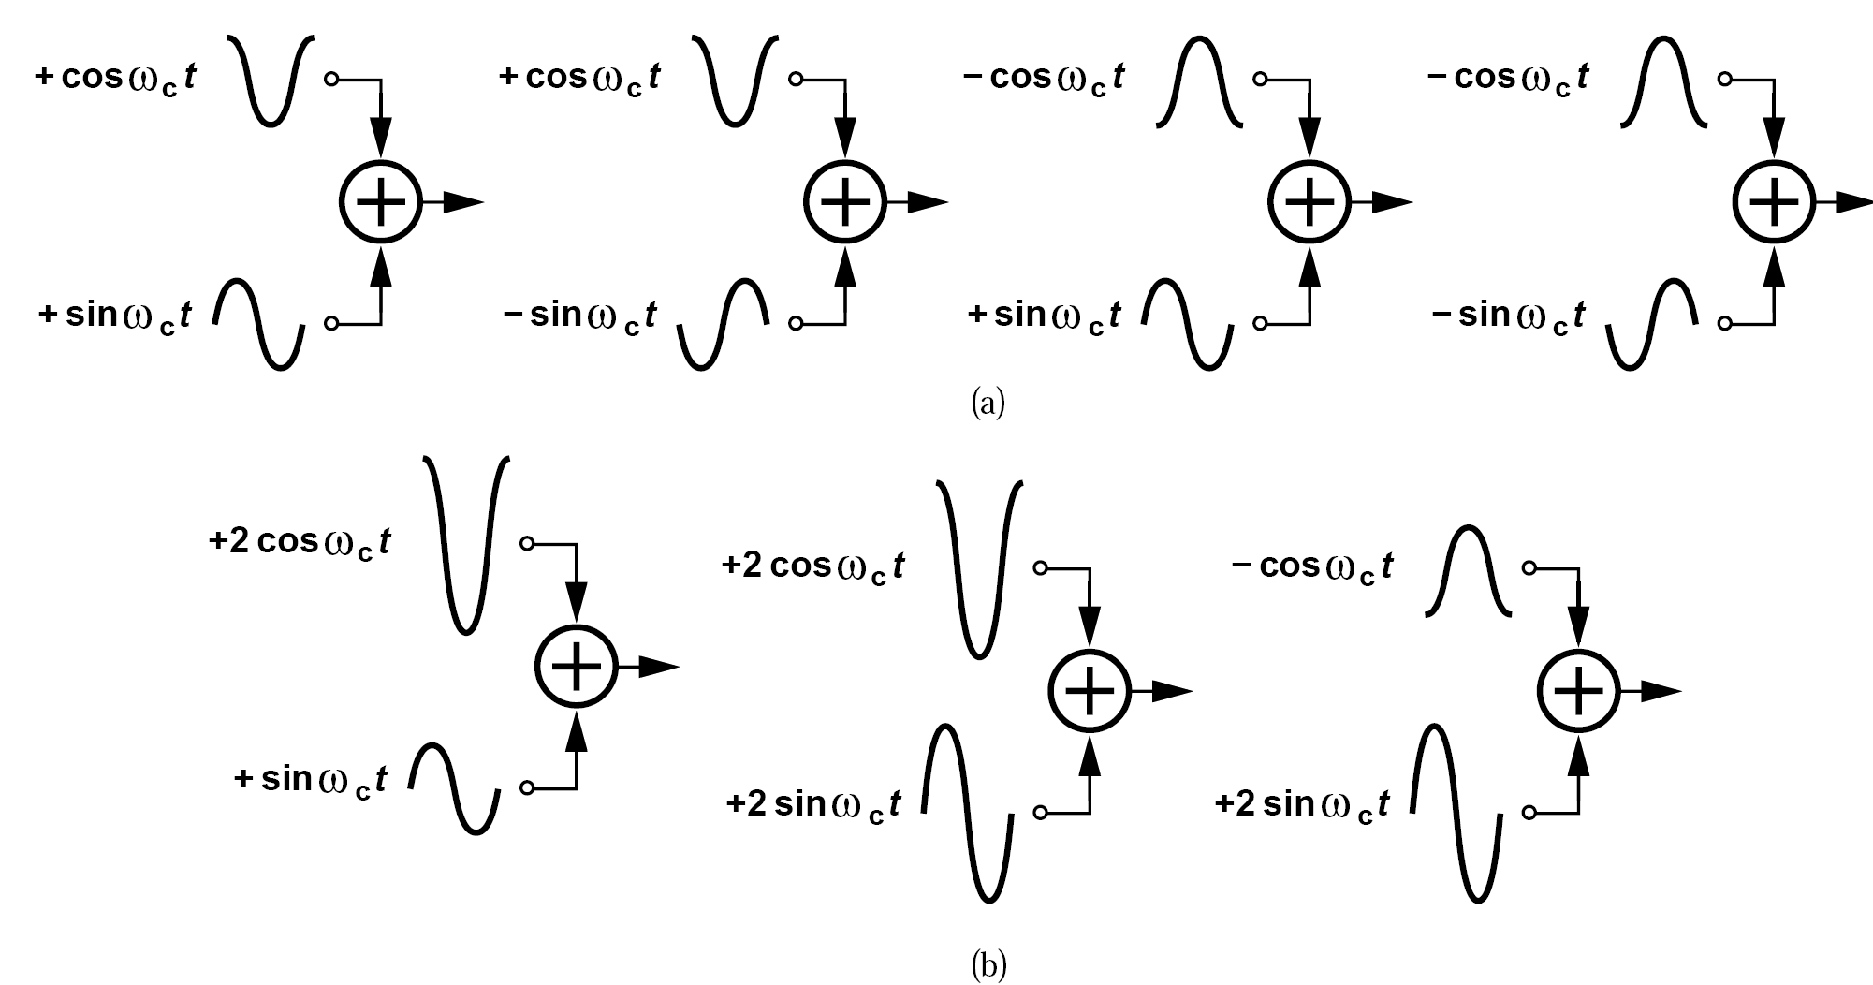
Quadrature Amplitude Modulation (QAM)
QAM allows four possible amplitudes for sine and cosine, ±1, ±2

Slide 30
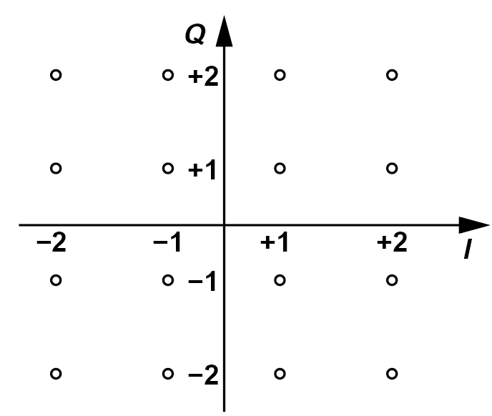
Quadrature Amplitude Modulation: Constellation
Saves bandwidth
Denser constellation: making detection more sensitive to noise
Large envelope variation: need highly linear PA

Slide 31

OFDM: Multipath Propagation
OFDM: Orthogonal Frequency Division Multiplexing
Multipath Propagation may lead to considerable intersymbol interference

Slide 32

How OFDM Works
In OFDM, the baseband data is first demultiplexed by a factor of N The N streams are then impressed on N different carrier frequencies.

Slide 33
Example of OFDM
It appears that an OFDM transmitter is very complex as it requires tens of carrier frequencies and modulators (i.e., tens of oscillators and mixers). How is OFDM realized in practice?
Solution:
In practice, the subchannel modulations are performed in the digital baseband and subsequently converted to analog form. In other words, rather than generate a₁(t) cos[ω_{c}t+Φ₁(t)]+a₂(t) cos[ω_{c}t+Δωt+Φ₂ (t)]+···, we first construct a₁(t) cos Φ₁(t)+a₂(t) cos[Δωt+Φ₂(t)]+···and a₁(t) sinΦ₁(t)+a₂(t) sin[Δωt+Φ₂(t)]+ ···.These components are then applied to a quadrature modulator with an LO frequency of ω_{c}.

Slide 34

Mobile RF Communications: Cellular System
Immediate neighbors cannot utilize same frequency
The mobile units in each cell are served by a base station, and all of the base stations are controlled by a “mobile telephone switching office” (MTSO)

Slide 35

Co-Channel Interference
CCI: depends on the ratio of the distance between two co-channel cells to the cell radius, independent of the transmitted power
Given by the frequency reuse plan, this ratio is approximately equal to 4.6 for the 7-cell pattern.

Slide 36

Hand-off
When a mobile unit roams from cell A to cell B, since adjacent cells do not use the same group of frequencies, the channel must also change.
Second-generation cellular systems allow the mobile unit to measure the received signal level from different base stations, thus performing hand-off when the path to the second base station has sufficiently low loss

Slide 37


Path Loss and Multi-Path Fading (Ⅰ)
Direct path: signals experience a power loss proportional to the square of the distance
Reflective path: loss increases with the fourth power of the distance
Multi-path fading: two signals possibly arriving at the receiver with opposite phases and roughly equal amplitudes, the net received signal may be very small

Slide 38





Path Loss and Multi-Path Fading (Ⅱ)
The overall received signal can be expressed as

Slide 39
Diversity & Interleaving
Diversity
Space Diversity or Antenna Diversity employs two or more antennas spaced apart by a significant fraction of the wavelength so as to achieve a higher probability of receiving a nonfaded signal
Frequency Diversity refers to the case where multiple carrier frequencies are used
Time Diversity: the data is transmitted or received more than once to overcome short-term fading
Interleaving
Errors occur in clusters of bits
To lower the effect of these errors, the baseband bit stream in the transmitter undergoes “interleaving” before modulation

Slide 40

Delay Spread
Two signals in a multipath environment can experience roughly equal attenuations but different delays.
Small delay spread yield a relatively flat fade whereas large delay spreads introduce considerable variation in the spectrum

Slide 41


Time and Frequency Division Duplexing
TDD: same frequency band is utilized for both transmit and receive paths but the system transmits for half of the time and receives for the other half.
FDD: employ two different frequency bands for the transmit and receive paths.

Slide 42
TDD vs. FDD: Features of TDD
TDD: two paths (RX,TX) do not interfere because the transmitter is turned off during reception
TDD: allows direct (peer-to-peer) communication between two transceivers
TDD: strong signals generated by all of the nearby mobile transmitters fall in the receive band, thus desensitizing the receiver.

Slide 43

TDD vs. FDD: Features of FDD
FDD: components of the transmitted signal that leak into the receive band are attenuated by typically only about 50 dB.
FDD: owing to the trade-off between the loss and the quality factor of filters, the loss of the duplexer is typically quite higher than that of a TDD switch.
FDD: spectral leakage to adjacent channels in the transmitter output

Slide 44


Frequency-Division / Time-Division Multiple Access
FDMA: available frequency band can be partitioned into many channels, each of which is assigned to one user.
TDMA: same band is available to each user but at different times

Slide 45
TDMA Features: Compared with FDMA
TDMA: power amplifier can be turned off during the time of the frame out of assigned time slot
TDMA: digitized speech can be compressed in time by a large factor, smaller required bandwidth.
TDMA: even with FDD, TDMA bursts can e timed so the receive and transmit paths are never enabled simultaneously
TDMA: more complex due to A/D conversion, digital modulation, time slot and frame synchronization, etc.

Slide 46



Code-Division Multiple Access: Direct-Sequence CDMA
Walsh’s recursive equation
CDMA allows the widened spectra of many users to fall in the same frequency band

Slide 47


Direct-Sequence CDMA: Spectrum and Power
Desired signal is “despread”; Unwanted signal remains spread
Near/Far Effect: one high-power transmitter can virtually halt communications among others: Requires Power Control

Slide 48

Frequency-Hopping CDMA
Can be viewed as FDMA with pseudo-random channel allocation.
Occasional overlap of the spectra raises the probability of error

Slide 49
Wireless Standards: Common Specifications (Ⅰ)
1. Frequency Bands and Channelization:
Each standard performs communication in an allocated frequency
band
2. Data Rates:
The standard specifies the data rates that must be supported
3. Antenna Duplexing Method:
Most cellular phone systems incorporate FDD and other standards
employ TDD
4. Type of Modulation:
Each standard specifies the modulation scheme.

Slide 50
Wireless Standards: Common Specifications (Ⅱ)
5. TX output power:
The standard specifies the power levels that the TX must produce
6. TX EVM and Spectral Mask:
The signal transmitted by the TX must satisfy several requirements
like EVM and spectral mask
7. RX Sensitivity:
The standard specifies the acceptable receiver sensitivity, usually in
terms of maximum BER
8. RX Input Level Range:
The standard specifies the desired signal range that the receiver
must handle with acceptable noise or distortion

Slide 51


Wireless Standards: Common Specifications (Ⅲ)
9. RX Tolerance to Blocks:
The standard specifies the largest interferer that the RX must
tolerate while receiving a small desired signal.
Many standards also stipulate an intermodulation test

Slide 52


GSM: Air Interface and an Example
GSM standard is a TDMA/FDD system with GMSK modulation, operating in different bands and accordingly called GSM900, GSM1800, and GSM 1900
GSM specifies a receiver sensitivity of -102 dBm. The detection of GMSK with acceptable bit error rate (10-3) requires an SNR of about 9 dB. What is the maximum allowable RX noise figure?
Solution:

Slide 53

GSM: Blocking Requirements
With the blocker levels shown in above figure, the receiver must still provide the necessary BER

Slide 54
Example of GSM Blocking Tests
How must the receiver P_{1dB} be chosen to satisfy the above blocking tests?
Solution:
Suppose the receiver incorporates a front-end filter and hence provides sufficient attenuation if the blocker is applied outside the GSM band. Thus, the largest blocker level is equal to -23 dBm (at or beyond 3-MHz offset), demanding a P_{1dB} of roughly -15 dBm to avoid compression. If the front-end filter does not attenuate the out-of-band blocker adequately, then a higher P_{1dB} is necessary.

Slide 55

GSM Blocking Requirements: Spurious Response Exceptions
Worst-case channel for GSM blocking test:
GSM stipulates a set of spurious response exceptions, 6 in band, 24 out of band
Do not ease the compression and phase noise requirements.

Slide 56

GSM: Intermodulation Requirements
Desired channel 3 dB above the reference sensitivity level
A tone and a modulated signal applied at 800-kHz and 1.6-MHz offset at -49 dBm and BER requirement must be satisfied

Slide 57

Example of GSM Intermodulation Tests
Estimate the receiver IP₃ necessary for the above test.
Solution:
For an acceptable BER, an SNR of 9 dB is required, i.e., the total noise in the desired channel must remain below -108 dBm. 为啥？ In this test, the signal is corrupted by both the receiver noise and the intermodulation. If, from previous example, we assume NF = 10 dB, then the total RX noise in 200 kHz amounts to -111 dBm. Since the maximum tolerable noise is -108 dBm, the intermodulation can contribute at most 3 dB of corruption. In other words, the IM product of the two interferers must have a level of -111 dBm so that,
along with an RX noise of -111 dBm, it yields a total corruption of -108 dBm. It follows from Chapter 2 that

Slide 58

GSM: Adjacent-Channel Interference
Desired channel 20 dB above the reference sensitivity level
Must withstand an adjacent-channel interferer 9 dB above desired signal or and alternate-adjacent channel interferer 41 dB above signal

Slide 59


GSM: TX Specifications
Transmitter must deliver an output of at least 2 W in the 900-MHz band or 1 W in the 1.8-GHz band
Must be adjustable in steps of 2 dB from +5 dBm to the maximum level
The maximum noise that the TX can emit in the receive band must be les than -129 dBm/Hz.

Slide 60

GSM: EDGE
Enhanced Data Rates fro GSM Evolution: 384kb/s, 8-PSK modulation
Need pulse shaping, linear PA; requires a higher SNR

Slide 61

Wideband CDMA: Air Interface
BPSK for uplink, QPSK for downlink, nominal channel bandwidth 5MHz, rate 384 kb/s
IMT-2000: total bandwidth 60 MHz, data rate 384 kb/s in a spread bandwidth of 3.84 MHz, channel spacing 5 MHz

Slide 62

Wideband CDMA: Transmitter Requirements
Output power: -49 dBm to +24 dBm. Adjacent and alternate adjacent channel power 33 dB and 43 dB below main channel.

Slide 63


Wideband CDMA: Receiver Requirements
Blocking mask using a tone:
Blocking test using a modulated interferer:
Reference sensitivity: -107 dBm. Sinusoidal test for only out-of-band blocking

Slide 64
Example of Wideband CDMA Receiver Requirements (Ⅰ)
Estimate the required P_{1dB} of a WCDMA receiver satisfying the in-band test of figure above.
Solution:
To avoid compression, P_{1dB} must be 4 to 5 dB higher than the blocker level, i.e., P1dB ≈ -40 dBm. To quantify the corruption due to cross modulation, we return to our derivation in Chapter 2. For a sinusoid A₁ cos ω₁t and an amplitude-modulated blocker A₂(1 + mcos ω_{m}t) cos ω₂t, cross modulation appears as

Slide 65





Example of Wideband CDMA Receiver Requirements (Ⅱ)
Estimate the required P_{1dB} of a WCDMA receiver satisfying the in-band test of figure above.
Solution:

Slide 66


Wideband CDMA Receiver Requirements: Intermodulation Test & Adjacent Channel Test
IMT-2000 intermodulation test:
A tone and a modulated signal each at -46 dBm applied in the adjacent and alternate adjacent channels, desired signal at -104 dBm
IMT-2000 receiver adjacent-channel test:
Desired signal -93 dBm, adjacent channel -52 dBm

Slide 67

Bluetooth: Air Interface
2.4-GHz ISM band. Each channel carries 1 Mb/s, occupies 1 MHz

Slide 68






Bluetooth Transmitter Characteristics: Modulation

Slide 69

Bluetooth Transmitter Characteristics: Spectrum Mask
Bluetooth specifies an output level of 0 dBm.
Bluetooth TX must minimally interfere with cellular and WLAN systems
Carrier frequency of each Bluetooth carrier has a tolerance of ±75 kHz

Slide 70


Bluetooth Receiver Characteristics: Blocking Test
Reference sensitivity of -70 dBm.
Blocking test for adjacent and alternate channels:
desired signal 10dB higher than reference sensitivity. Adjacent channel with equal power, modulated. Alternate adjacent channel with -30 dBm, modulated.
Blocking test for third or higher adjacent channel:
Desired signal 3 dB above sensitivity, modulated blocker in third or higher adjacent channel with power -27 dBm.

Slide 71

Bluetooth Receiver Characteristics: Out-of-band Blocking Test
Reference sensitivity of -70 dBm.
Out of band Blocking Test:
Desired signal -67 dBm, tone level of -27 dBm or -10 dBm must be tolerated according to the tone frequency range.

Slide 72

Bluetooth Receiver Characteristics: Intermodulation Test
Reference sensitivity of -70 dBm.
Intermodulation Test:
Desired signal 6 dB higher than reference sensitivity, blockers applied at -39 dBm with Δf = 3, 4, or 5 MHz
Maximum usable input level -20 dBm

Slide 73
Example of Maximum Usable Input Specification
Does the maximum usable input specification pose any design constraints?
Solution:
Yes, it does. Recall that the receiver must detect a signal as low as -60 dBm; i.e., the receiver chain must provide enough gain before detection. Suppose this gain is about 60 dB, yielding a signal level of around 0 dBm (632 mV_{pp}) at the end of the chain. Now, if the received signal rises to -20 dBm, the RX output must reach +40 dBm (63.2 V_{pp}), unless the chain becomes heavily nonlinear. The nonlinearity may appear benign as the signal has a constant envelope, but the heavy saturation of the stages may distort the baseband
data. For this reason, the receiver must incorporate “automatic gain control” (AGC), reducing the gain of each stage as the input signal level increases (Chapter 13).

Slide 74

IEEE 802.11 a/b/g: Air Interface
Channel spacing 20 MHz

Slide 75

IEEE 802.11 a/b/g: OFDM Channelization
OFDM: 52 subcarriers with spacing of 0.3125 MHz, middle sub-channel and first and last 5 sub-channels are unused. 4 subcarriers are occupied by BPSK-modulated “pilots”.

Slide 76

IEEE 802.11 a: Transmission Mask
TX must deliver a power of at least 40 mW.
Pulse shaping: 16.6 MHz
Carrier leakage: 15 dB below the overall output power.

Slide 77

IEEE 802.11 a: Data Rates, Sensitivities, Adjacent Channel Levels
11a/g receiver must operate properly with a maximum input -30 dBm

Slide 78
Example of Noise Figure and 1-dB Compression Point Calculation in 802.11a/g
Estimate the noise figure necessary for 6-Mb/s and 54-Mb/s reception in 11a/g.
Solution:
First, consider the rate of 6 Mb/s. Assuming a noise bandwidth of 20 MHz, we obtain 19 dB for the sum of the NF and the required SNR. Similarly, for the rate of 54 Mb/s, this sum reaches 36 dB. An NF of 10 dB leaves an SNR of 9 dB for BPSK and 26 dB for 64QAM, both sufficient for the required error rate. In fact, most commercial products target an NF of about 6 dB so as to achieve a sensitivity of about -70 dBm at the highest date rate.
Estimate the 1-dB compression point necessary for 11a/g receivers.
Solution:
With an input of -30 dBm, the receiver must not compress. Furthermore, recall from previous section that an OFDM signal having N subchannels exhibits a peak-to-average ratio of about 2 lnN. For N = 52, we have PAR = 7.9. Thus, the receiver must not compress even for an input level reaching -30 dBm + 7.9 dB = -22.1 dBm. The envelope variation due to baseband pulse shaping may require an even higher P_{1dB}.

Slide 79

IEEE 802.11 b Overlapping Channel Frequencies
11b specifies overlapping channel frequencies to offer greater flexibility. Users operating in close proximity of one another avoid overlapping channels
The carrier frequency tolerance is ±25 ppm

Slide 80

IEEE 802.11 b Transmission Mask
11b standard stipulates a TX output power of 100 mW (+20 dB) with the spectrum mask.

Slide 81

Appendix I: Differential Phase Shift Keying
Differential Encoding
Differential Decoding

Slide 82


References (Ⅰ)

Slide 83

References (Ⅱ)

